Slide 1
Introduction to Cloud Computing Unit 3- Day3 S/W dev in cloud – Part1
Prashant Kaushal

Slide 2
Recap
Cloud Architecture and Application Management

Slide 3
Intro
SaaS applications that are different and offer many advantages when compared to traditional applications
the SaaS delivery option is not suitable for all kinds of applications
bring a lot of challenges to developers with regard to SaaS application development

Slide 4
SaaS apps
SaaS is a promising software delivery and business model
The applications will be deployed by the SaaS provider in their managed or hosted infrastructure.
The end users can access the hosted application as a service whenever there is a need.
has one-to-many relationships with the end users and the software.
follows the multitenant architecture, and it allows many customers to share a single instance of the software, popularly known as multitenancy

Slide 5
SaaS key differences
• SaaS provides web access to commercial software on pay-as-you-use basis. • SaaS applications are developed, deployed, and managed from a central location by the service provider. • It allows the same instance of the SaaS application to be shared by multiple customers or tenants. • Updates are performed by the service provider, not by the user. • SaaS applications allow service integration with other third-party services through application programming interfaces (APIs) provided by them.

Slide 6
SaaS benefits
Pay per use
Zero infrastructure
Ease of access
Automated updates
Composite services
Dynamic scaling
Green IT solutions

Slide 7
SaaS un-suitability
• Some real-time applications where fast processing of data is needed • Applications where the organization’s data are more confidential and the organization does not want to host their data externally • Applications where existing on-premise applications fulfill the organization’s needs

Slide 8
SaaS suitabiity
• For applications where the end user is looking for on-demand software rather than full-term/licensing-based software • For a start-up company that cannot invest more money on buying licensed software • For applications that need the accessibility from handheld devices or thin clients • For applications with unpredictable and dynamic load

Slide 9
SaaS app dev- Perspectives
SaaS from Managed Infrastructure and Platform
SaaS from IaaS and Managed Platform
SaaS from Managed Infrastructure and PaaS
SaaS from IaaS and PaaS

Slide 10
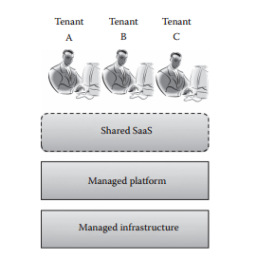
SaaS from Managed Infrastructure and Platform
This model uses the traditional infrastructure and the platform for developing and deploying the SaaS application. Cloud computing characteristics will be satisfied only at the SaaS layer.

Slide 11
SaaS from Managed Infrastructure and Platform
Pros • This type of SaaS delivery model ensures more security to the user data as the infrastructure and platform are maintained by the SaaS provider. • The SaaS provider gets full control over the infrastructure and development platform. • There is no problem of vendor lock-in. The application can be easily migrated to any other infrastructure without any major modification. Cons • More overhead in maintaining the underlying infrastructure and platform. • The service providers have to invest more on the infrastructure. So, this model is not suitable for SaaS development companies that do not have much amount to invest. • Since the development environment is managed by the service provider, there is an additional overhead of maintaining the scalability and availability of the application. • Resource utilization will be very low.

Slide 12
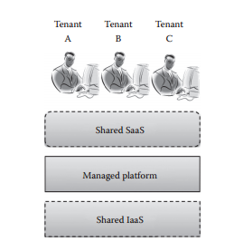
SaaS from IaaS and Managed Platform
In this type of service delivery model, the SaaS providers can use the infrastructure provided by any IaaS provider.

Slide 13
SaaS from IaaS and Managed Platform
Pros • Ensures high resource utilization at the infrastructure level. • Reduces the capital investment on the infrastructure. • Capital investment can be reduced.
Cons • Still there is additional overhead in maintaining the development platform. • Has to enable highly scalable and available features manually. • There is a possibility of vendor lock-in at the infrastructure layer.

Slide 14
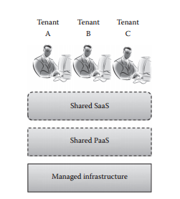
SaaS from Managed Infrastructure and PaaS
SaaS can be developed and delivered from self-managed infrastructure and shared PaaS.

Slide 15
SaaS from Managed Infrastructure and PaaS
Pros • The scalability and availability of the application will be provided by PaaS by default. So, the SaaS provider can concentrate more on application development. • Security will be moderated, and there is full governance over user data. Cons • Even though overhead in maintaining the development platform is reduced, the overhead in maintaining the infrastructure still remains unsolved. • This type of model will be suitable only for private/public SaaS applications. As the load on the public SaaS is high and unpredictable, the service providers may have to buy a new additional infrastructure to handle extra load. This is not possible for small SaaS development companies.

Slide 16
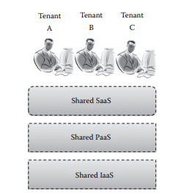
SaaS from IaaS and PaaS
This type of SaaS development and delivery model gets all the benefits of cloud computing.

Slide 17
SaaS from IaaS and PaaS
Pros • The best delivery model that suits public SaaS applications. • Ensures high resource utilization as it enables multitenancy at all layers of the application. It also supports Green IT applications. • Dynamic scaling of IaaS and PaaS provider ensures the high scalability of the application. SaaS development companies need not worry about the scalability of the application. • The high availability of the applications is ensured by the replica and the backup and recovery mechanism provided by the service provider. • No overhead in maintaining the infrastructure and development platform. This enables SaaS development companies to develop more applications in a short span of time.
Cons • Since this type of model mostly uses public IaaS and PaaS models, the application will be hosted as off-premise applications. So, there is no governance over customer data. • There is a possibility of cross tenant attacks as multitenancy is enabled at all levels of the application.

Slide 18
SaaS – New Challenges
Multitenancy
Security
Scalability
Availability
Usability
Self-Service Sign-Up
Automated Billing
Nondisruptive Updates
Service Integration
Vendor Lock-In

Slide 19
Thanks

